Slide 1
Interoperability
Georeferencing Web Services

Slide 2
Current Services:
Georeferencing:
  GEOLocate
  BioGeomancer
Validation:
  Taxonomic Footprint Validation
Collaboration:
  CoGe

Slide 3
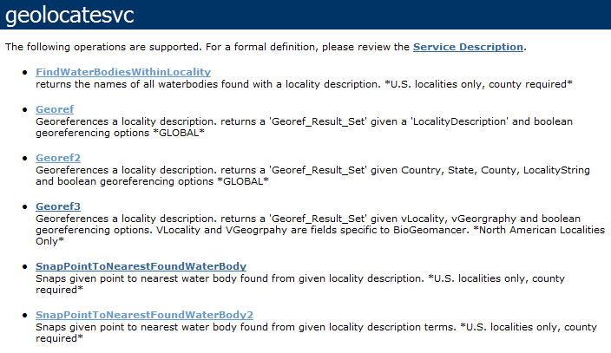
GEOLocate Web Services
SOAP & HTTP Get/Post
  http://www.museum.tulane.edu/webservices/geolocatesvc/geolocatesvc.asmx

Slide 4
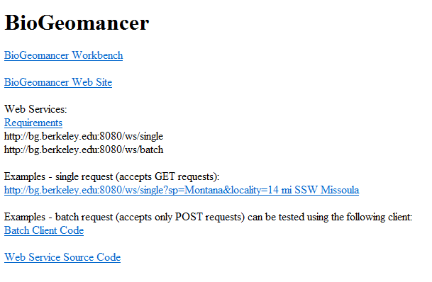
BioGeomancer Web Services
HTTP Get/Post
  http://bg.berkeley.edu

Slide 5
Collaborative Georeferencing

Slide 6
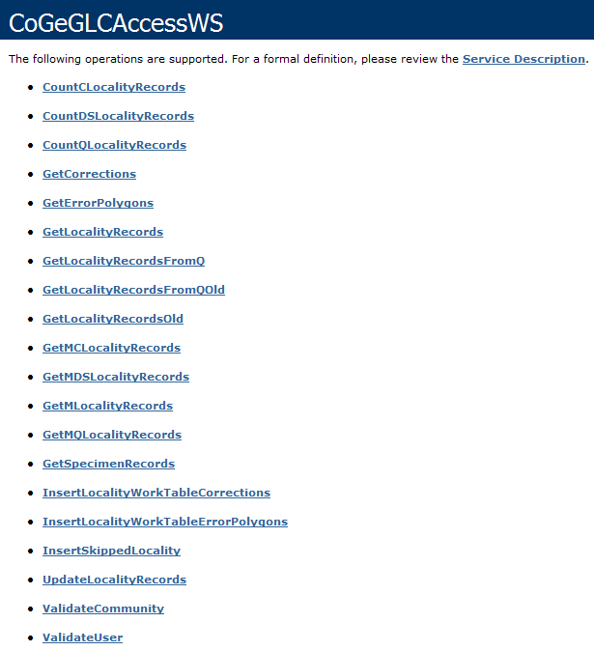
CoGe Web Services
SOAP Only
http://www.museum.tulane.edu/webservices/CoGeGLCAccessWS/CoGeGLCAccessWS.asmx

Slide 7
Collaborative Georeferencing Services Documentation
http://www.museum.tulane.edu/geolocate/developers/CoGeGLCAccessWS_Doc.pdf

Slide 8
Taxon Footprint Services
HTTP SOAP & Get/Post:
XML & KML output options
Get with XML Output:
http://www.museum.tulane.edu/taxonfootprint/tfp.aspx?Species=Phoxinus+erythrogaster|ictalurus+furcatus&lat=30&lon=-89&format=raw
Get with KML Ouptut:
http://www.museum.tulane.edu/taxonfootprint/tfp.aspx?Species=Phoxinus+erythrogaster|ictalurus+furcatus&lat=30&lon=-89&format=kml
SOAP:
http://www.museum.tulane.edu/webservices/bigfootws/bigfoot.asmx

